Slide 1

Day 2
RESPONSE
What might stop us from getting help for someone?
A Comprehensive High School-Based Youth Suicide Prevention Program
© Upstream Suicide Prevention LLC
Notes:
Please ask students if they have any questions or concerns from previous lesson
Answer questions if needed
Today we are going to look at barriers (attitudes and behaviors) that might make it feel hard to get support for someone who is struggling or having thoughts of suicide.
Please ask students to define attitudes and behaviors
Validate all responses and redirect if inappropriate
Please ensure final definitions are similar to those below:
Attitudes: Beliefs and ideas
Behavior: Actions that are taken
Let students know that this discussion will be started with a true story about a person who died by suicide. While communication styles today are different, things like this still happen.
Sometimes, if we have lost someone to suicide, talking about things like this can be tough. It can bring up a lot of emotions.
Please note that the story isn’t being shared to blame the teens; instead it is being shared so we can talk about the things that might keep a person from getting help for someone and explore ways to move past those barriers. Also, if you are a loss survivor, and you begin to notice things that maybe could have helped the person you lost, please know that you are not to blame. We can’t do things until we learn the skills to do them.
If students are needing support through the conversation, please share the policy the school has about supporting students in distress

Slide 2
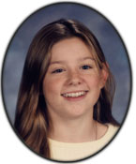
A True Story
Jennifer gave a note to a friend that was passed around at a baseball game. At least 5 people read the note, but no one got help. The note read, “If I’m not here on Monday, I’m dead. No joke.”
The parents found the note under the bleachers and discovered that no one said anything before their daughter killed herself.
Notes:
Please give students a moment to read the slide, then read it aloud
Please pass out the worksheet entitled “Barriers” and ask students to read the first four questions. Let students know we will be responding to those questions later in the lesson
If students are being chosen to respond by number, please be sure to hand students a number
Draw a T chart on the board
One side will be titled ‘Barriers’ and the other will be titled ‘Breaking the Barrier’
Let students know that during the following discussions, this chart will be filled out as barriers and ways to push through those barriers are discussed
Please also note that it can be helpful to think about the barriers we might have in reaching out for help ourselves, as we talk about the barriers in getting help for others

Slide 3
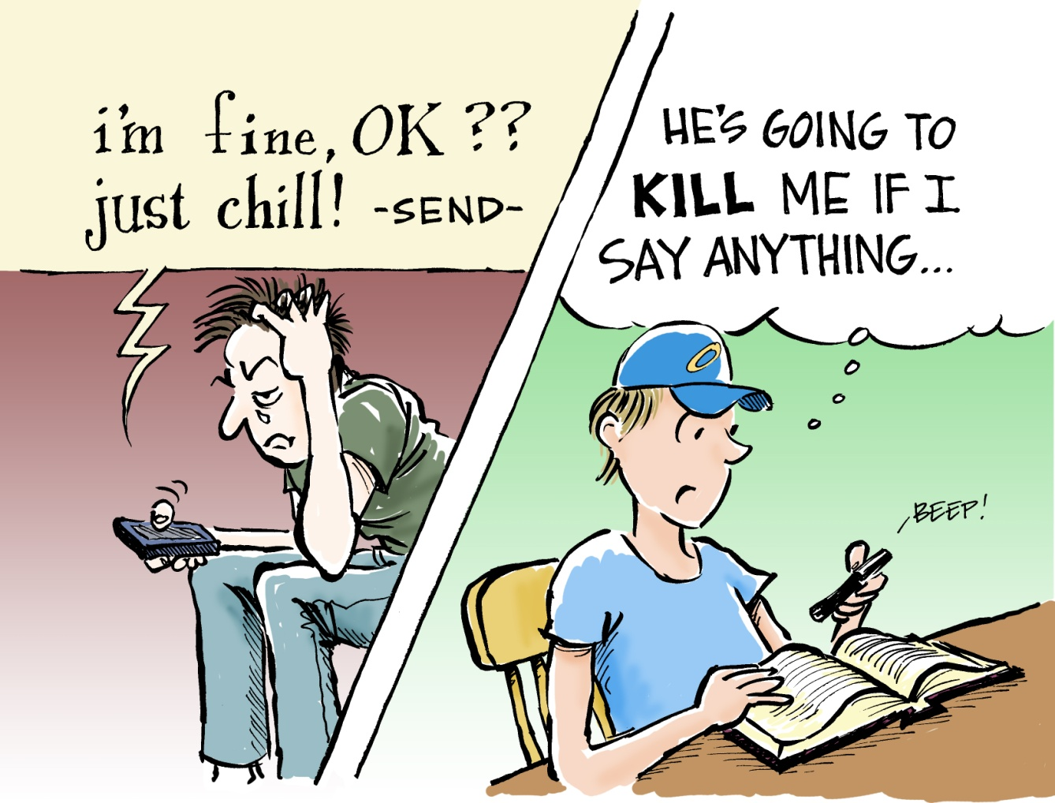
Barrier #1
My friend will be angry if I get help.
Notes:
Let students know that a common barrier is thinking that a person will be angry if someone gets someone else, especially an adult, involved
Please ask students the following questions to start a discussion
Validate all responses and encourage ways to break down barriers that are mentioned
What might make a person feel this way?
What might keep a person from wanting an adult involved?
How might we help a person to know how important support is?
What will help us to feel as comfortable as possible in doing this?

Slide 4
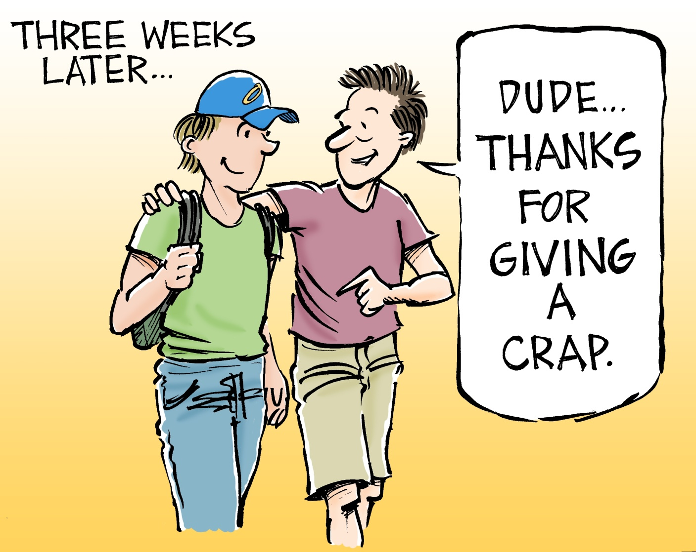
I care enough about my friend and their safety to get them support,
so they get the help they need.
Most often, our friend will be glad we did.
Notes:
If someone were to pass out, we would definitely get help for that person, by getting someone who can do first aid. The same immediate response and reaching out for supports needs to be done for a person who is thinking about suicide. Getting support will not only ensure our friends gets the help they need, but could also help them to stay safe.
Just like physical first aid, staff at the school have received training to be able to support people who are having thoughts of suicide
Sometimes our friend might be upset that someone else knows they are struggling- to me, it shows how much we care about our friends that we are willing to get help for them to be safe, even if it means they might be mad.
Most folks appreciate the support, even if they are initially upset
Ask students to get into pairs. Ask them to answer the first 4 questions on the worksheet; let them know they will have 5 minutes
If students are being chosen to respond by number, please be sure to hand each pair a number
When students are ready to respond, please pull a number from a basket and ask the pair with the matching number to share their responses
For all versions of this activity: (If not done previously) Please draw a chart on the board with one side being ‘Barriers’ and the other being ‘Breaking the barriers’
Use students responses to fill in the chart
Example
Barrier: Afraid my friend will get mad
Breaking the barrier: Letting my friend know I care about them and don’t want them to get hurt, so I’m reaching out for support
ALTERNATIVE If asking each group to give one response or idea, please inform students of this.
When students are ready to respond, please ask each group to share one answer from their discussion
What are some things that stopped people from getting help for Jennifer?
What might have helped them get help for Jennifer?
What are some things that might stop your or a friend from getting help for someone who is struggling or thinking of suicide?
What are some things that would help you or a friend to get help for someone who is struggling or thinking of suicide?

Slide 5
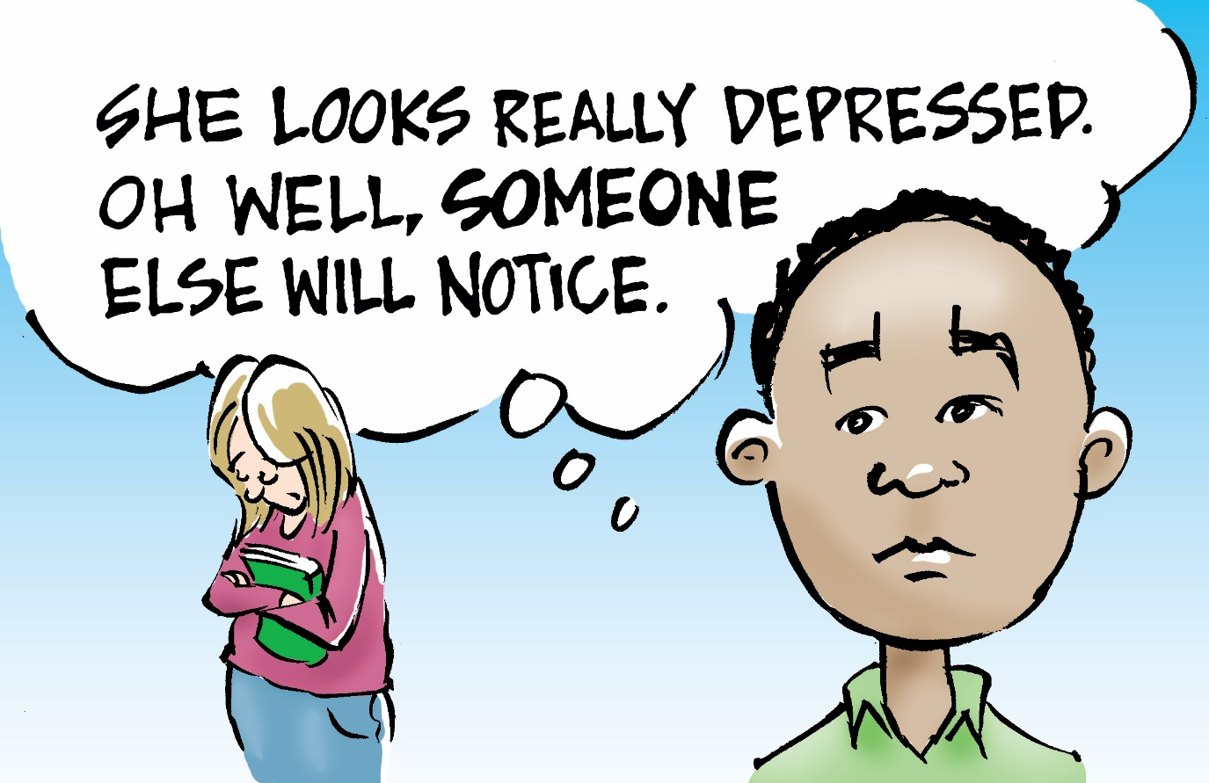
Barrier #2
Avoiding someone who is struggling/ thinking of suicide because we think someone else will help.
Notes:
Let students know another common barrier is not reaching out because we believe that someone else will notice and offer support (This discussion can be shortened if this has already been discussed)
Please ask students the following questions to start a discussion
Validate all responses and encourage ways to break down barriers that are mentioned
What might make a person feel this way?
What might keep a person from wanting an adult involved?
How might we help a person to know how important support is?
What will help us to feel as comfortable as possible in doing this?

Slide 6
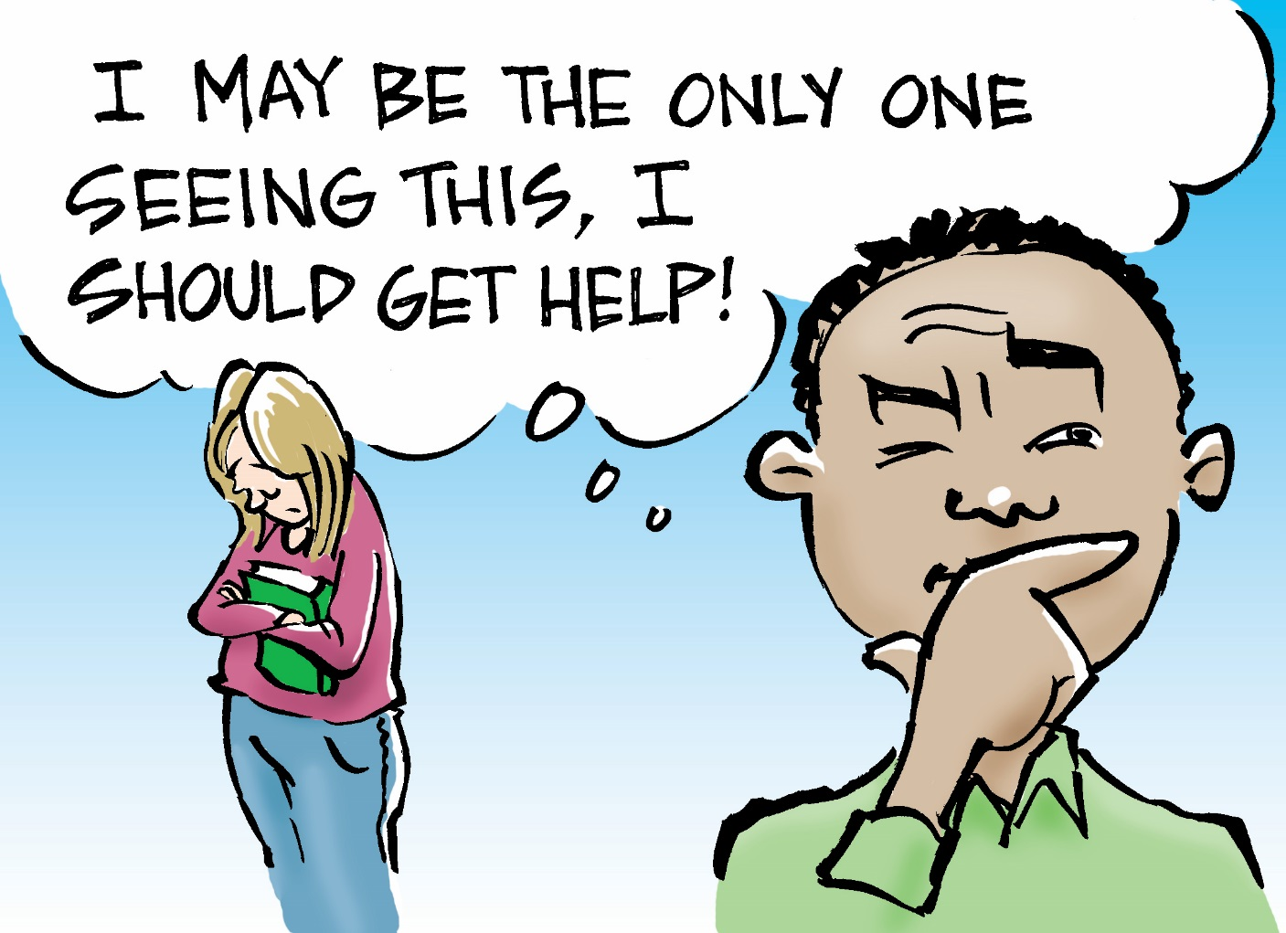
You may be the only one noticing this. If you don’t say anything, this person may not get help.
Notes:
It is incredibly important to get support if we notice a person is struggling
We may be the only one to notice
It takes a lot of bravery to reach out and offer/ get support
If we don’t get support, the person struggling may not get the support they need to stay safe
Ask students to get into pairs. Ask them to answer the last 2 questions on the worksheet; let them know they will have 5 mins
If students are being chosen to respond with slips of paper, please be sure to hand each pair a number.
When students are ready to respond, please pull a number from a basket and ask the pair with the matching number to share their responses
ALTERNATIVE If asking each group to give one response or idea, please inform students of this.
When students are ready to respond, please ask each group to share one answer from their discussion
Do you think Jennifer wanted someone to help? Why/ Why not?
Why can it be harmful to joke about suicide?
We have learned a lot today about the barriers to getting support for someone who is struggling or thinking of suicide (If number slips were used, please collect for use during another activity)
Students will now get a chance to determine when they feel they might reach out for support for someone who is struggling
Rating Line Activity
Pass out the Rating Line- Others Worksheet
Please ask students to take 5 minutes to place the number corresponding to each of the statements on the line depending on how likely they would be to reach out to an adult for support if they noticed a fellow student doing the things mentioned on the sheet
Group Discussion
After students have finished their worksheets, ask for students to share where they placed the number for each statement
Ask students to share what made them place their number where they did
If students have different thoughts, please encourage them to share their ideas as part of the discussion rather than having it be a debate
ALTERNATIVE
After students have finished their worksheets, let them know that one side of the room is designated for ‘Would Definitely Say Something’ (there could be signs for this if desired) and the other for ‘Would Definitely NOT Say Something’, and that the middle of the room is ‘Somewhere in the middle’. As each statement is made, students will move to the side of the room (or the middle) where they placed the number on their sheet
Ask students to stand and read through each statement.
Ask students to share what made them place their number where they did
If students have different thoughts, please encourage them to share their ideas as part of the discussion rather than having it be a debate
Following the activity, let students know that, while folks have different times they would reach out, there are some that most folks would reach out about. Other things we might not, unless there were several together.
No matter if it is one or many things, please encourage students to reach out for support if anything is making them concerned that a friend might be thinking about suicide
Gut feelings are sometimes the most powerful thing we have, and that is ok!
There are times that, even if we reach out and do all the right things, a person may die by suicide
I am not saying this to stop you from offering support, because doing so in incredibly important. Rather, I am saying it because it is important that you get support if this ever happens to you
The fear that this might happen can be a huge barrier for some folks.
In breaking that barrier, it is incredibly important to remember that showing another person that they are noticed and cared about can be incredibly powerful, and the regret we might feel if we did not offer support is something that would we want to avoid.

Slide 7
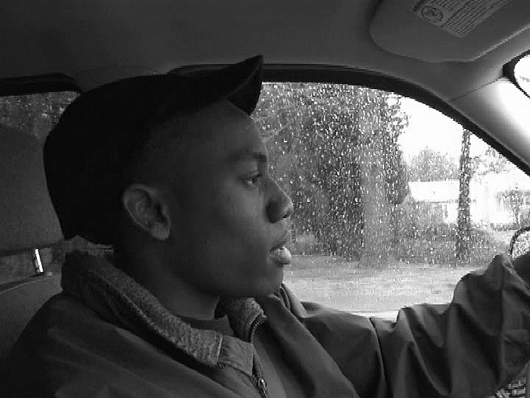
Day 3
RESPONSE STUDENT COMPONENT
How Can I Help?
A Comprehensive High School-Based Youth Suicide Prevention Program
© Upstream Suicide Prevention LLC
Notes:
Ask students if they have any questions or concerns that came up from the previous lesson
The conversation today will be about knowing when to reach out for support, and who can be reached out to- both within and outside of school
Remind students that some discussions may be challenging
Please remind students of self care and support contacts if they need to talk or need support

Slide 8
Want to check in on someone?
Start a conversation.
Ask the question, “Are you thinking about suicide?”
If “yes,” please stay with the person until you are able to get more support for them.
Let the person know you care and are there for them. While it may be tempting, try to avoid offering advice.
Accompany your friend to the suicide safety contact or counselor at your school, or contact them and have them come to you if that would be easier for your friend.
Notes:
There are five steps we can take if we think someone may be thinking of suicide
Start a conversation
What might we say to start the conversation?
Please validate all responses, or redirect if the responses are disrespectful
Please be sure the following are included
Let the person know what you noticed
Let them know that you care
Ask the question, ‘Are you thinking about suicide?’
What might be important about using the word suicide?
Please validate all responses, or redirect if the responses are disrespectful
Please validate that using the word can be scary, but it is incredibly important
Please be sure the following are included
If we do not use the word suicide, the person might not know that is what we mean
When we use the word suicide, we are showing that we respect the seriousness of the situation
When we use the word suicide, we are letting the person know that we are willing to talk about a really intense subject
Where might be best to have this conversation?
Please validate all responses, or redirect if the responses are disrespectful
Please be sure the following are included
In a quiet, non crowded space
In a space where the person feels comfortable
We will be talking about what to do if someone says ‘no’, but we are still worried about them during class tomorrow
If yes, please stay with the person until you are able to get more support for them
Why is this so important?
Please validate all responses, or redirect if the responses are disrespectful
Please be sure the following are included
It is important the person is able to stay safe until support can be reached
If we leave immediately, the person may feel dismissed or as if they scared us away
Let the person know you care and are there for them. While it may be tempting, try to avoid offering advice
What might we say to show that we care?
Please validate all responses, or redirect if the responses are disrespectful
Please be sure the following are included
I’m here for you
I’m so glad you told me
I can hear you are in a lot of pain
Please see handout for others
Why might offering advice not be helpful?
Please validate all responses, or redirect if the responses are disrespectful
Please be sure the following are included
When someone is feeling stuck, advice can seem dismissive
It might make someone feel like you think they are not able to solve their own problems
We don’t know what might be best for someone else
Accompany your friend to the suicide safety contact or counselor at your school, or contact them and have them come to you if that would be easier for your friend.
Why is this step so important?
Please validate all responses, or redirect if the responses are disrespectful
Please be sure the following are included
It is vital that a person thinking of suicide gets support to be safe
If you are able to go with your friend, is reinforces your caring and commitment to their safety
If the person refuses to go with us or leaves, please contact an adult immediately
Please pass out the handout ‘How to Help’
Here are some more ideas on what to say when we are talking to someone about their thoughts of suicide
In the next class, we will talking about helping someone who is refusing support

Slide 9
Who Can I Get Support From?
A suicide safety contact is someone at this school who is specifically trained to help a student who is thinking about suicide.
1.
2.
Reach out if needed
>> YouthLine 877-968-8491 or text teen2teen to 839863
>> LifeLine 800-273-8255 or text 273TALK to 839863
Notes:
We have mentioned that there is a suicide safety contact we can get support from throughout this lesson
While all staff have some training, these people have been through extra training and are able to best support someone who is thinking about suicide
These folks are able to offer support to anyone having thoughts of suicide, whether that person be a friend or yourself
There are folks in our lives, like friends and teachers, who are able to offer support, but may not have the training to help a person to be safe if they are having thoughts of suicide.
Ensure the students know who the two suicide safety contacts are in the school
These are the folks who have the training to make sure a person gets the support they need to be safe
Please have suicide safety contacts introduce themselves and share their role at the school (if needed)

